Slide 1

EV Charging Infrastructure Intelligence Dashboard
Comprehensive Analysis using Power BI, Power Query, and DAX
TEAM MEMBERS: ATHARV MILIND SURYAVANSHI, SHREEDHAR SANJAY KUMBHAR TECHNOLOGY: MICROSOFT POWER BI STACK | 2025

Slide 2
Project Overview & Abstract
This project transforms raw global charging station records into interactive business intelligence. Our goal is to assess infrastructure reliability, operator footprints, and connector standards across 10,000 unique records.

Slide 3






PROBLEM STATEMENT
Data Quality Issues
Complexity
Geographic Gaps
Raw datasets suffer from missing city/state info, inconsistent operator naming (e.g. "chargepoint" vs "Charge Point"), and duplicate records.
Multiple connector types stored in single delimited fields (e.g. CCS|Type 2) make granular hardware analysis impossible without splitting.
Non-standardized country codes (CA, RU, MY) and invalid coordinates hinder precise map visualizations and regional comparison.

Slide 4
PROJECT OBJECTIVES
Cleanse & Preprocess: Standardize country/operator names and handle null values.
Data Transformation: Split connector strings and validate geographic coordinates.
Dynamic Modeling: Develop calculated columns and advanced DAX measures.
Visual Intelligence: Create a 3-page interactive dashboard (Executive, Infra, Details).
Actionable Insights: Enable drill-through analysis from macro trends to micro station data.

Slide 5
END-TO-END WORKFLOW
Raw Data
Power Query
DAX Logic
Visualization
Insights
CSV Ingestion (10K Records)
Standardization & Cleaning
Measures & Calculations
Interactive Dashboards
Stakeholder Reporting

Slide 6
DATASET ARCHITECTURE
Field Name | Type | Business Purpose
Station Name | Text | Primary identifier for localized locations.
Country Code | Text | Mapped from CA/US to readable Country Names.
Num Connectors | Numeric | Foundation for Capacity Categorization (Small/Med/Large).
Status | Text | Standardized to Operational / Non-Operational.
Coordinates | Geographic | Lat/Lon used for street-level mapping validation.

Slide 7

POWER QUERY PIPELINE
Replacement: Null operators replaced with "Unknown Operator".
Standardization: Regex used to group fragmented names (flo/FLO).
Parsing: Connector types split by "|" delimiter into distinct rows.
Formatting: Date Added converted to uniform datetime formats.

Slide 8

CALCULATED INTELLIGENCE (DAX)
// Station Operational Flag
// Operational Stations Count
These measures enable dynamic filtering and high-performance KPI rendering across all dashboard pages.

Slide 9
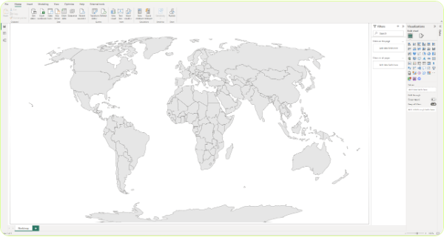
EXECUTIVE DASHBOARD INSIGHTS
93%
Operational Availability
~10K
Total Charging Stations
1.46
Avg Connectors Per Station

Slide 10
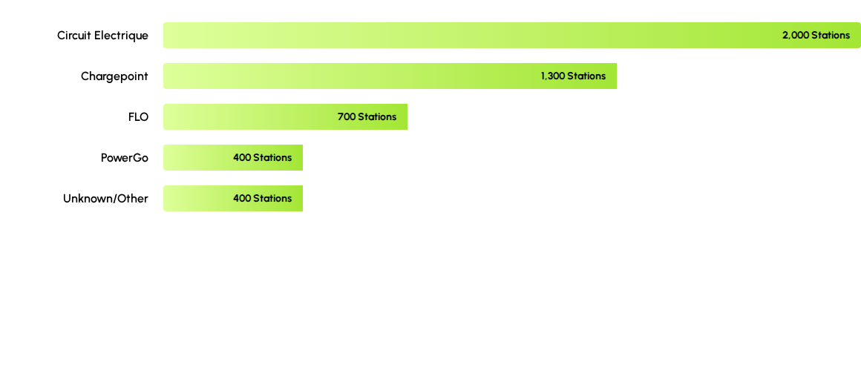
TOP CHARGING OPERATORS
Circuit Electrique dominates the network, controlling roughly 20% of the total infrastructure in the dataset.

Slide 11
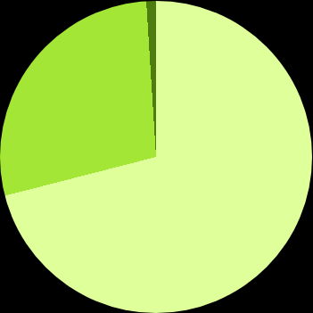
INFRASTRUCTURE DISTRIBUTION
Small (1 Connector): 7,100 (70.99%)
Medium (2-4 Connectors): 2,800 (27.89%)
Large (5+ Connectors): 100 (1.12%)
Nearly 3 out of 4 stations are small-scale deployments, highlighting a decentralized micro-hub strategy across North America.

Slide 12
Any Questions?
Project Conclusion & Future Roadmap
Live API Integration | Predictive Demand Modeling | ML-based Failure Forecasts
Thank you for your time.

